Slide 1


Slide 2

Tutorial 3 Sections 009/010
TA: Greydon Gilmore
Physiology 2130
Sep 23rd, 2019

Slide 3

Your TA reminding you…
1st Peerwise assignment (1.5%)
Post 2 MC questions: due Oct 16th @ midnight
Answer 5 MC questions: due Oct 18th @ midnight
Currently 47 inactive users
Only 10 students completed
1st Quiz (1%)
Opens: Oct 21st @ 4pm
Closes: Oct 22nd @ 4pm
1st Midterm - Oct 25th @ 6pm-7pm (15%)

Slide 4
Today
Learning Catalytics Quiz
Group work
Osmolarity and tonicity
Action potential

Slide 5
Group Work

Slide 6
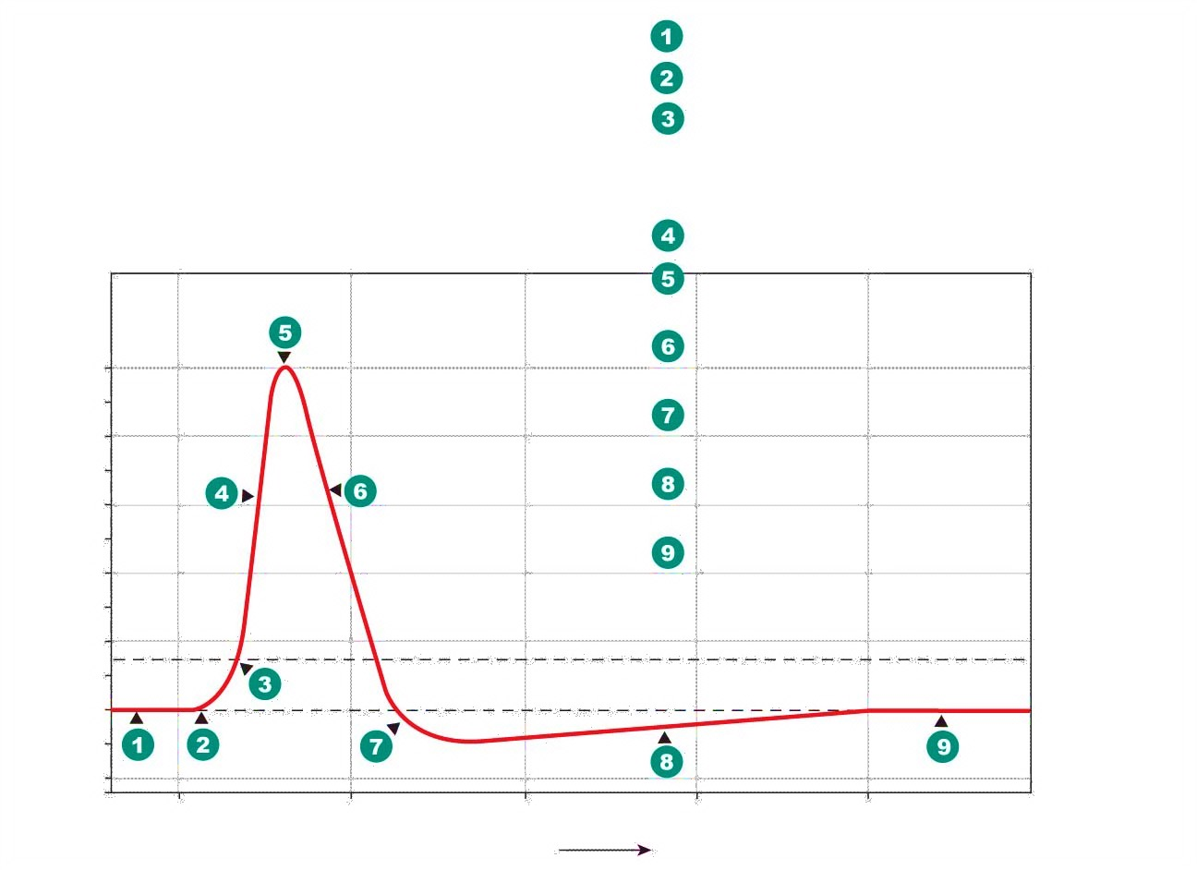
Activity #1: Labelling the Action Potential
One VG Na⁺ and one VG K⁺
Place appropriate channel on:
4, 6, 8 and 1/9
Indicate if gates are open/closed: draw the gates
Take a picture and each group member needs to upload to learning catalytics site

Slide 7
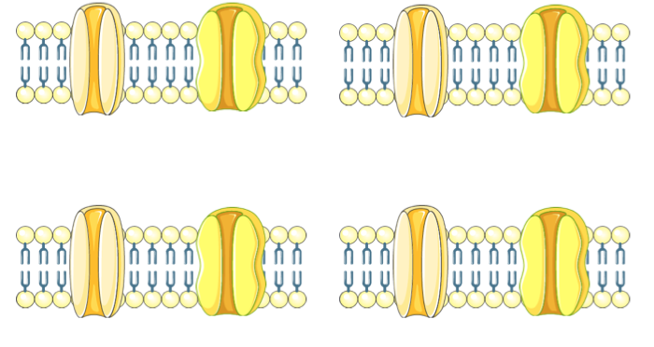
4 Channel Diagrams – label gate configurations for the Na+ voltage-gated channel and the K+ voltage-gated channel and position on the action potential diagram

Slide 8
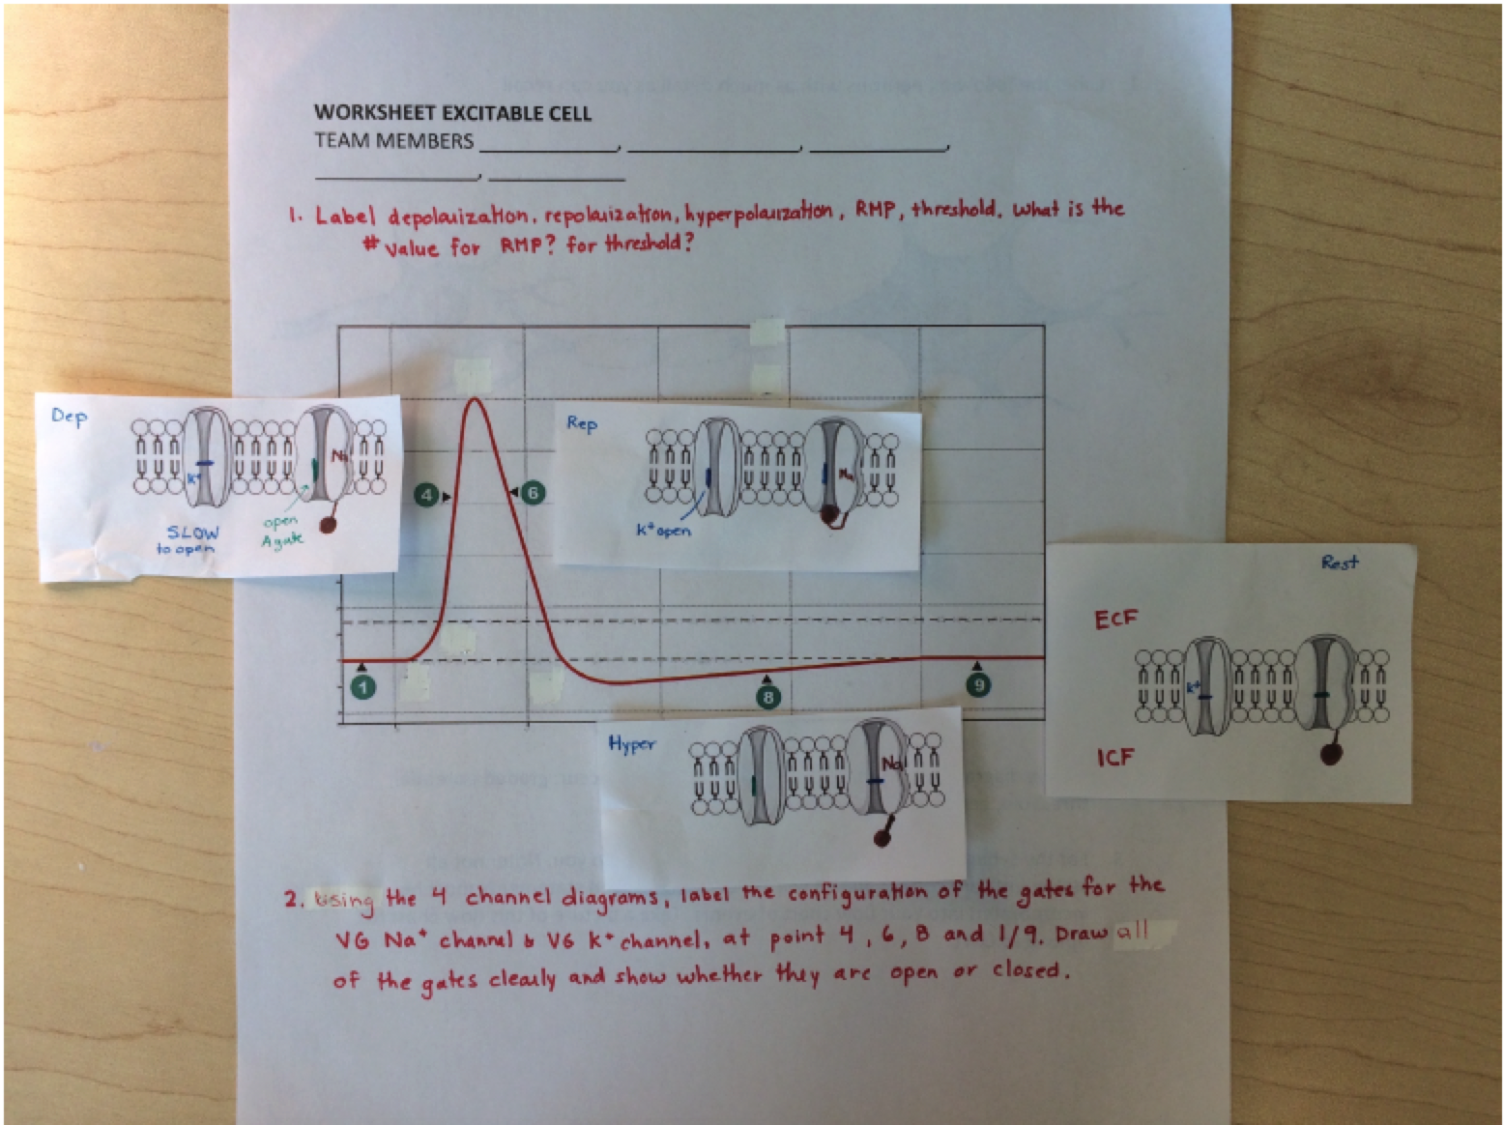
Activity #1: Answers

Slide 9
Activity #2: Ordering the events of a chemical synapse
Login to the Pearson Mastering site https://www.pearsonmylabandmastering.com/northamerica/
Order the events that occur at the chemical synapse
If two events occur at same time, then stack them
Every group member should submit their own, but work as a group to solve

Slide 10
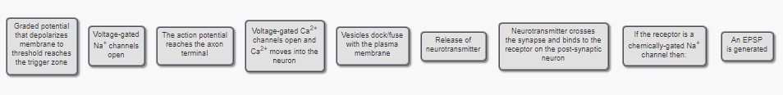
Learning Activity Excitable Cell Answer

Slide 11
Review Questions

Slide 12
Which of the following statements are TRUE regarding osmosis?
The osmotic pressure of a solution is proportional to the concentration of the solute
A 100 mM NaCl solution has a greater osmolarity than a 100mM LiCl solution because Na is larger than Li
The permeability of the membrane affects osmosis
Osmosis is the movement of a solute down its concentration gradient
If only 1, 2 and 3 are correct
If only 1 and 3 are correct
If only 2 and 4 are correct
If only 4 is correct
If ALL are correct

Slide 13
Which of the following statements are TRUE regarding osmosis?
The osmotic pressure of a solution is proportional to the concentration of the solute
A 100 mM NaCl solution has a greater osmolarity than a 100mM LiCl solution because Na is larger than Li
The permeability of the membrane affects osmosis
Osmosis is the movement of a solute down its concentration gradient
If only 1, 2 and 3 are correct
If only 1 and 3 are correct
If only 2 and 4 are correct
If only 4 is correct
If ALL are correct

Slide 14
Which of the following statements regarding the cell’s membrane potential is TRUE?
Only neurons have a membrane potential
When an electrochemical equilibrium is reached (i.e. the electrical gradient force of an ion is equal in magnitude to its chemical gradient force), there is no movement of this ion across the membrane
The RMP is generated by the Na/K pump
It is affected by the concentration gradient of ions and the membrane permeability
If only 1, 2 and 3 are correct
If only 1 and 3 are correct
If only 2 and 4 are correct
If only 4 is correct
If ALL are correct

Slide 15
Which of the following statements regarding the cell’s membrane potential is TRUE?
Only neurons have a membrane potential
When an electrochemical equilibrium is reached (i.e. the electrical gradient force of an ion is equal in magnitude to its chemical gradient force), there is no movement of this ion across the membrane
The RMP is generated by the Na/K pump
It is affected by the concentration gradient of ions and the membrane permeability
If only 1, 2 and 3 are correct
If only 1 and 3 are correct
If only 2 and 4 are correct
If only 4 is correct
If ALL are correct

Slide 16
Which of the following cells are excitable?
Neurons
Cardiac Muscle Cells
Smooth Muscle Cells
Skeletal Muscle Cells
If only 1, 2 and 3 are correct
If only 1 and 3 are correct
If only 2 and 4 are correct
If only 4 is correct
If ALL are correct

Slide 17
Which of the following cells are excitable?
Neurons
Cardiac Muscle Cells
Smooth Muscle Cells
Skeletal Muscle Cells
If only 1, 2 and 3 are correct
If only 1 and 3 are correct
If only 2 and 4 are correct
If only 4 is correct
If ALL are correct
Excitable Cells:
Generate and respond to electrical signals
Include neurons and muscle cells

Slide 18
Learning Catalytic Question

Slide 19
Osmosis, tonicity and the resting membrane potential
Chapter 1: Dr. Woods
pp.

Slide 20
Osmosis
Osmosis is the net movement of WATER down its concentration gradient
It is affected by:
permeability of the membrane
concentration gradient of solutes
pressure gradient across the cell membrane
Osmolarity is concerned only with the NUMBER OF PARTICLES in solution (NOT size or type/composition)

Slide 21
Tonicity
Tonicity: the ability of a solution to cause osmosis across biological cell membranes
Isotonic: same osmolarity as body fluids
Hypotonic: lower osmolarity than body fluids
Hypertonic: higher osmolarity than body fluids
Chemical Gradient: molecules move from high concentration to low concentration
Electrical Gradient: electrically charged molecules (ions) move to areas of opposite charge

Slide 22
A red blood cell is placed in a 200 mM BeCl2 solution. The cell will _______ because the solution is _______.
shrink; hypotonic
shrink; hypertonic
swell; hypotonic
swell; hypertonic

Slide 23
A red blood cell is placed in a 200 mM BeCl2 solution. The cell will _______ because the solution is _______.
shrink; hypotonic
shrink; hypertonic
swell; hypotonic
swell; hypertonic
RBC = 300 mOsm
Solution = 200 mM x 3 ions
= 600 mOsm
The solution is hypertonic
Water moves out of cell into the solution, causing the cell to shrink

Slide 24
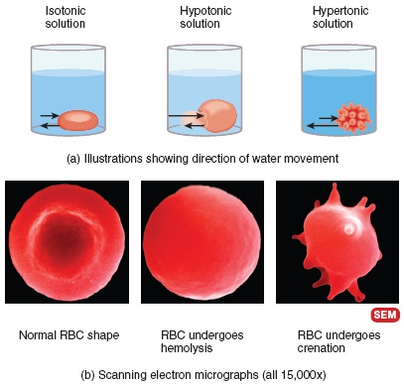
Tonicity: Review
Less solute
More solute

Slide 25
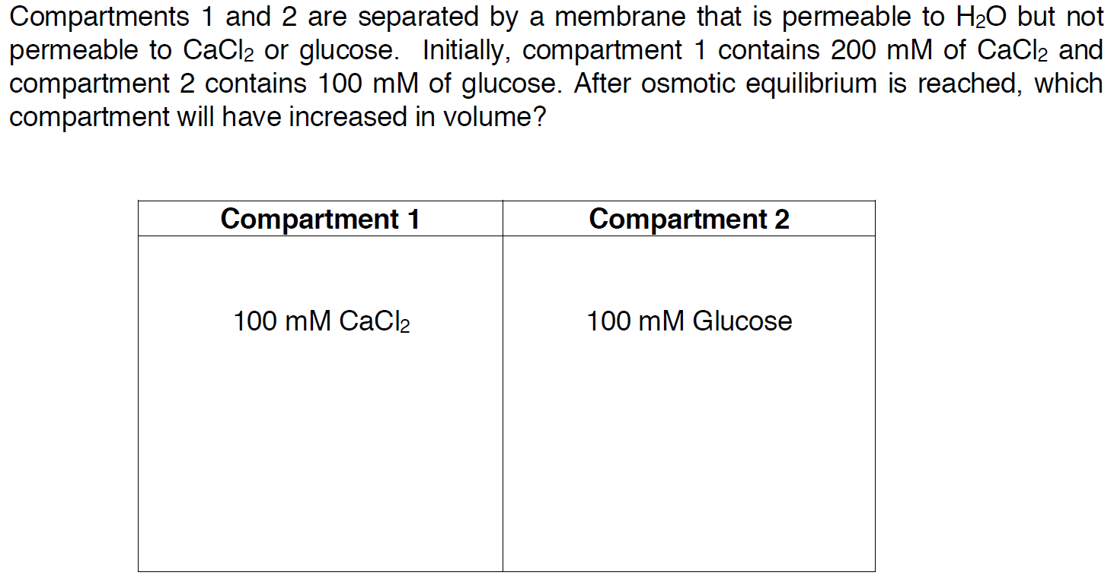
Compartment Question
200mM

Slide 26
Compartment Question
200mM
= (200 mM x 1 Ca²⁺) +
(200 mM x 2 Cl⁻)
= 600 mOsm
= 100 mOsm

Slide 27
Terms you should know
Active transport: moves molecules against their concentration gradient and requires an outside source of energy
Extracellular fluid: body fluid compartment found outside of cells
Facilitated diffusion: a mediated-transport process that moves molecules from higher to lower concentrations across a membrane by means of a transporter until the two concentrations become equal.
Gap junctions: allow chemical and electrical signals to pass directly from cell to cell
Glycoprotein: protein with sugar groups attached
Homeostasis: the maintenance of a relatively constant internal environment
Hydrophobic: molecules that do not dissolve easily in water
Hypertonic: a fluid bathing a cell that would cause a cell to shrink
Interstitial fluid: extracellular fluid surrounding cells, excludes plasma
Paracrine: a chemical that is secreted and communicates locally with a neighbouring cell
Plasma: the liquid portion of blood, a component of extracellular fluid

Slide 28
The Action Potential
Chapter 1: Dr. Woods
pp.

Slide 29
Which of the following structures are correctly associated with their function?
Dendrites send outgoing signals
Myelin insulates axons to prevent ion/current leak
There are no ion channels at the Nodes of Ranvier
There are no organelles at the soma

Slide 30
Which of the following structures are correctly associated with their function?
Dendrites send outgoing signals
Myelin insulates axons to prevent ion/current leak
There are no ion channels at the Nodes of Ranvier
There are no organelles at the soma

Slide 31
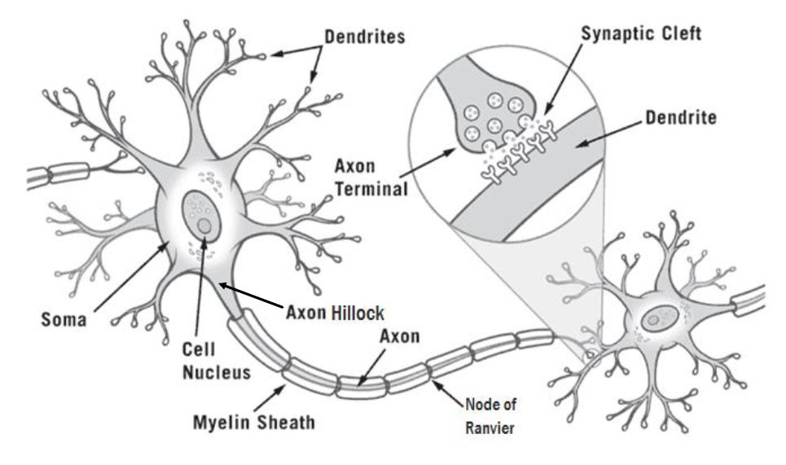
The Neuron

Slide 32
Key Events and Their Locations
Incoming information received by the dendrites
Graded potentials occur in the dendrites/soma
An action potential is fired at the axon hillock if threshold is met
The action potential travels along the myelinated axon via salutatory conduction
The action potential arrives at the axon terminal of the pre-synaptic cell and the message is passed to the post-synaptic cell

Slide 33
What is a main difference between a graded potential and an action potential?
Graded potentials do not experience current leak, whereas action potentials do
Graded potentials travel a long distance, whereas action potentials travel a short distance
Graded potentials occur at the soma, whereas action potentials start at the axon hillock
The amplitude of the graded potentials is not proportional to the stimulus strength, whereas the amplitude of action potentials is proportional to the stimulus strength

Slide 34
What is a main difference between a graded potential and an action potential?
Graded potentials do not experience current leak, whereas action potentials do
Graded potentials travel a long distance, whereas action potentials travel a short distance
Graded potentials occur at the soma, whereas action potentials start at the axon hillock
The amplitude of the graded potentials is not proportional to the stimulus strength, whereas the amplitude of action potentials is proportional to the stimulus strength

Slide 35
Graded Potentials vs. Action Potentials
Graded Potentials | Action Potentials
Occur at dendrites/somas | Occur at axon hillock
Caused by mechanical or chemical-gated channels | Caused by voltage-gated channels
Can be a depolarization or hyperpolarization | Always a depolarization
Amplitude of potential is directly proportional to stimulus strength | All or nothing–Amplitude of potential is constant no matter the stimulus strength
Travel short distances | Travel long distances

Slide 36
Depolarization is caused by the opening of ____, causing ___ to flow ___ the cell.
VG Na+ channels; Na+ ions; into
VG Na+ channels; Na+ ions; out of
VG K+ channels; K+ ions, into
VG K+ channels; K+ ions, out of

Slide 37
Depolarization is caused by the opening of ____, causing ___ to flow ___ the cell.
VG Na+ channels; Na+ ions; into
VG Na+ channels; Na+ ions; out of
VG K+ channels; K+ ions, into
VG K+ channels; K+ ions, out of

Slide 38
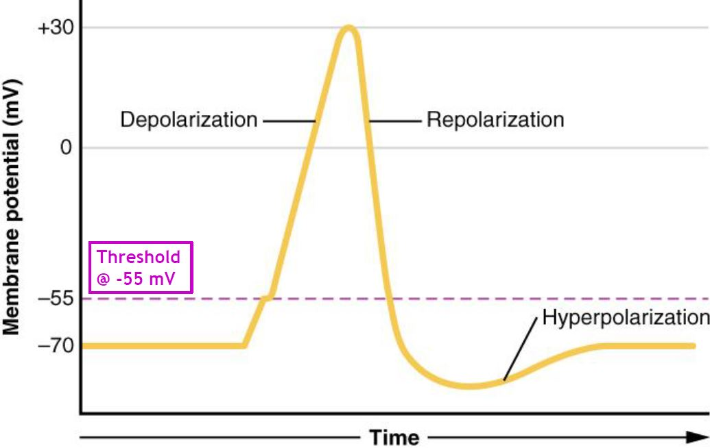
The Action Potential
Depolarization
Potential becomes more +ve
VG Na⁺ C open (fast)
Na⁺ flows into cell
VG K⁺ C start to open (slow)
Repolarization
Potential returns to RMP
VG Na⁺ C inactive
VG K⁺ C fully open
K⁺ flows out of cell
Absolute Refractory Period
Hyperpolarization
Potential becomes more –ve than RMP
VG Na⁺ C close
VG K⁺ C start to close (slow)
RMP
VG Na⁺ C close
VG K⁺ C fully closed

Slide 39
Propagation of The Action Potential
Chapter 1: Dr. Woods
pp.

Slide 40
Propagation of the AP
Myelin prevents ion/current leakage and allows for rapid saltatory conduction
Ion channels are concentrated at Nodes of Ranvier
The Na⁺ ions flow down the axon (like charges repels and opposites charges attract)
This brings the next segment of the axon to threshold and an AP is fired

Slide 41
Propagation of the AP
Initial stimulus @ soma
Threshold is met @ axon hillock and AP is fired
Depolarization (Na⁺ flows into the cell)
Na⁺ flows along the axon
That Na⁺ brings the next segment to threshold and AP is fired
Depolarization of next segment
(Na⁺ flows into the cell)
Repolarization of initial segment
(K⁺ flows out of the cell)

Slide 42
Which of the following events take place at a chemical synapse?
VG Ca2+ channels open, allowing Ca2+ to flow out of the cell
VG Ca2+ channels open, allowing Ca2+ to flow into the cell
Neurotransmitters travel from the post-synaptic cell to the pre-synaptic cell
Neurotransmitters travel from the pre-synaptic cell to the post-synaptic cell
If only 1, 2 and 3 are correct
If only 1 and 3 are correct
If only 2 and 4 are correct
If only 4 is correct
If ALL are correct

Slide 43
Which of the following events take place at a chemical synapse?
VG Ca2+ channels open, allowing Ca2+ to flow out of the cell
VG Ca2+ channels open, allowing Ca2+ to flow into the cell
Neurotransmitters travel from the post-synaptic cell to the pre-synaptic cell
Neurotransmitters travel from the pre-synaptic cell to the post-synaptic cell
If only 1, 2 and 3 are correct
If only 1 and 3 are correct
If only 2 and 4 are correct
If only 4 is correct
If ALL are correct

Slide 44
Synapse
What happens to extra neurotransmitters?
Recycled into axon terminal
Degraded by enzymes
Diffuse out of cleft
What happens to the post-synaptic cell?
If Na+ channels open: EPSP
Na⁺ into cell
Depolarization of post-synaptic cell (graded potential towards threshold) If K⁺ or Cl⁻ channels open: IPSP
K⁺ out of cell or Cl⁻ into cell
Hyperpolarization of post-synaptic cell (graded potential away from threshold)

Slide 45
Next Tutorial (Sep 30th)
Sensory System
Nervous system overview
Touch

Slide 46
What Questions Do You Have?
You can ask in the Owl forums as well!
Also anonymously ask questions in the online dropbox!!

